Slide 1
Analyzing the MD5 collision in Flame
Alex Sotirov
Co-Founder and Chief Scientist
Trail of Bits, Inc
SummerCon 2012

Slide 2
Overview of Flame
Discovered sometime in 2012
Active since at least 2010
Complex malware
almost 20MB in size
multiple components
Very limited targeted attacks

Slide 3

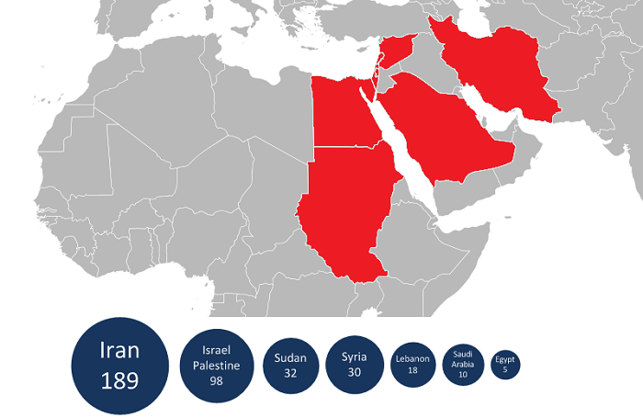
Source: Kaspersky Lab

Slide 4
Flame propagation
WPAD (Web Proxy Auto-Discovery Protocol)
Flame registers itself as a proxy server for update.microsoft.com and other domains
Serves a file called WuSetupV.exe, signed with a Microsoft code-signing certificate

Slide 5
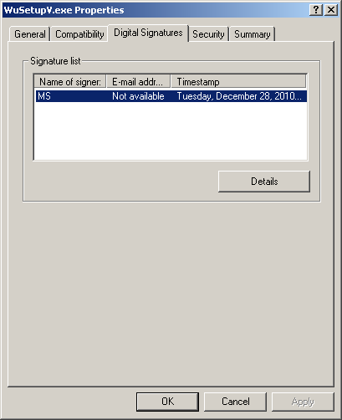

Slide 6
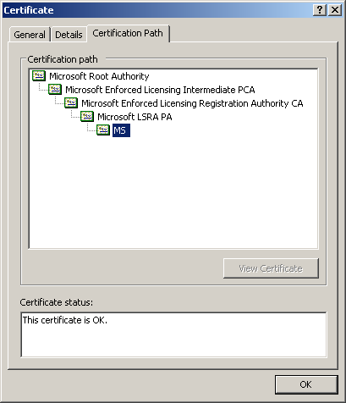

Slide 7


Certificate hierarchy
Microsoft Root Certificate Authority
Microsoft Windows Verification PCA
Microsoft Enforced Licensing Intermediate PCA
Microsoft Windows
Microsoft Enforced Licensing Registration Authority CA
Microsoft LSRA PA
ntdll.dll
MS ?!?!?
WuSetupV.exe

Slide 8
Terminal Services Licensing
Part II

Slide 9
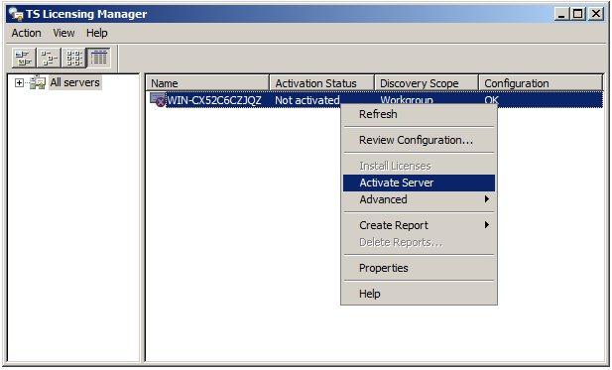
Terminal Services License Server

Slide 10
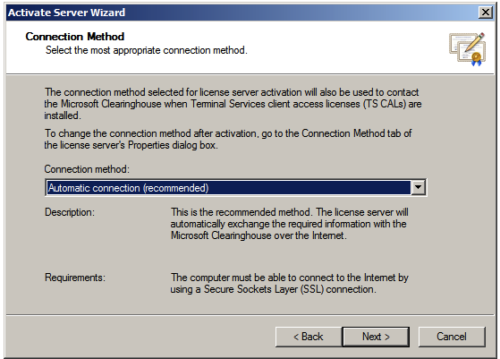
Terminal Services activation

Slide 11
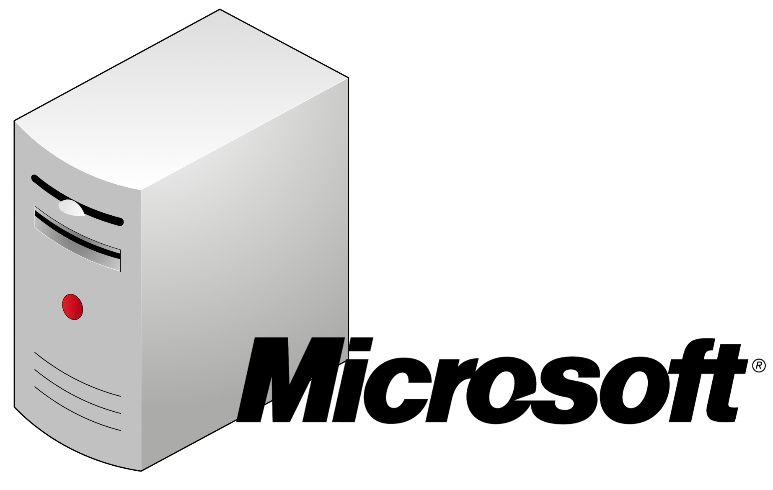



Terminal Services Licensing
CN=Microsoft LSRA PA
Certificate Signing Request
CN=Terminal Services LS
CN=computer name
Terminal Services
Terminal Services
License Server
RDP client

Slide 12
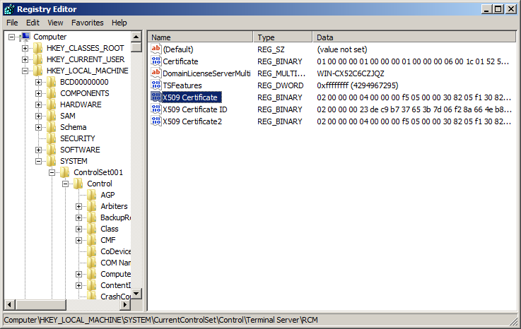
Terminal Services certificate

Slide 13
Terminal Services certificates
Subject is CN=Terminal Services LS
Valid until Feb 19, 2012
No other identifying information
No Extended Key Usage restrictions
inherited from the CA certificate, which allows code signing
Microsoft Hydra extension
certificate fails validation on Vista and Win7

Slide 14
MD5 collisions
Part III

Slide 15
RapidSSL attack in 2008
Collaboration of hackers and academics led by Marc Stevens and me
Demonstrated a practical MD5 collision attack against the RapidSSL CA:
Resulted in a rogue SSL certificate authority trusted by all browsers
Allows man-in-the-middle attacks on SSL
Presented at the CCC in 2008

Slide 16
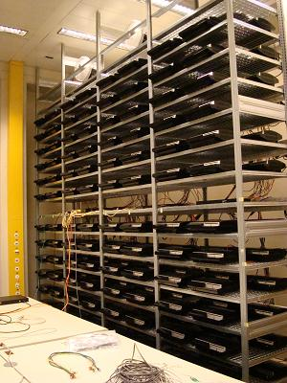
Collision generation
About 2 days on a cluster of 200 PS3s
Equivalent to about $20k on Amazon EC2

Slide 17
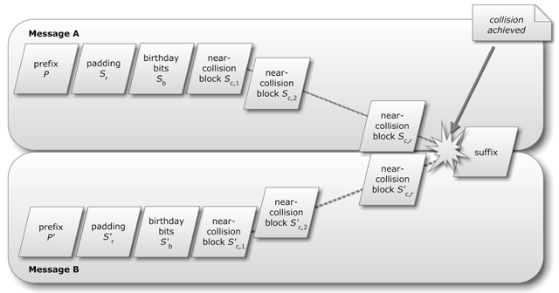
Chosen-prefix MD5 collisions
Source: Marc Stevens

Slide 18
Colliding certificates
serial number
serial number
validity period
validity period
chosen prefix
(difference)
real cert domain name
rogue cert domain name
real cert
RSA key
real cert
RSA key
collision bits
(computed)
X.509 extensions
X.509 extensions
identical bytes
(copied from real cert)
signature
signature

Slide 19
Challanges
The chosen prefix must be known before we can generate the collision bits
Collision generation took about 2 days
How do we predict the serial number and validity period of our certificate?

Slide 20
MD5 collision in Flame
Part IV

Slide 21
Colliding certificates
Flame certificate
Certificate signed by Microsoft
Serial number, validity
Chosen prefix
(difference)
Serial number, validity
CN=MS
CN=Terminal Services LS
+229
2048-bit RSA key (271 bytes)
+259
RSA key (509 bytes?)
+500
+504
issuerUniqueID data
+504
+512
birthday bits
+512
4 near collisions blocks
(computed)
+768
+768
Identical bytes
(copied from signed cert)
+786
X509 extensions
+1392
+1392
MD5 signature
MD5 signature

Slide 22
Challenges
Predicting the validity period
fully automated CA operation
validity period determined by time of request
Predicting the serial number
RapidSSL used sequential serial numbers, incremented by 1 for each certificate
Microsoft LSRA PA uses a different mechanism
Jul 19 13:41:52 2010 GMT 33:f3:59:ca:00:00:00:05:25:e0
Jan 9 20:48:22 2011 GMT 47:67:04:39:00:00:00:0e:a2:e3
Jun 7 01:24:51 2011 GMT 40:96:0b:b2:00:00:00:01:0c:30

Slide 23
Cryptographic complexity
64 birthday bits, 4 near collision blocks
Similar complexity to the RapidSSL attack
About $20k on Amazon EC2 in 2008, or cheaper if you have a large cluster

Slide 24
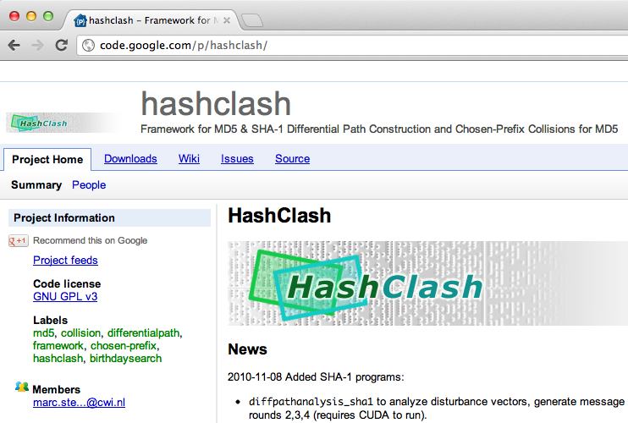

Slide 25
Cryptographic forensics
Using our forensic tool, we have indeed verified that a chosen-prefix collision attack against MD5 has been used for Flame. More interestingly, the results have shown that not our published chosen-prefix collision attack was used, but an entirely new and unknown variant. This has led to our conclusion that the design of Flame is partly based on world-class cryptanalysis.
Marc Stevens, CWI.nl

Slide 26
Remaining Questions
Was the collision generated with the open-source HashClash tool or developed independetly?
How did they predict the serial number?
How did Flame do TLS when spoofing the Windows Update webserver?

Slide 27
Questions?

